Slide 1





SQL PROJECT
AIRPORT DATA ANALYSIS
Vishal sinha

Slide 2
OBJECTIVE
The SQL project will analyze the Airport Data to identify the key factors such as airport operations by examining total passenger numbers and trends per route, average passengers per flight, flight frequency. It will compare passenger numbers across origin cities, access available seats, and identify popular destination airports. Additionally, the project will explore correlations between city population and passenger counts, as well as the impact of population size on flight frequency.

Slide 3
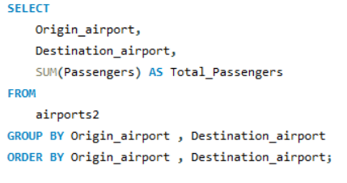
Problem Statement 1 :
The objective is to calculate the total number of passengers for each pair of origin and destination airports.
This will provide insights into travel patterns between specific airport pairs, helping to identify the most frequented routes and enhance strategic planning for airline operations.

Slide 4
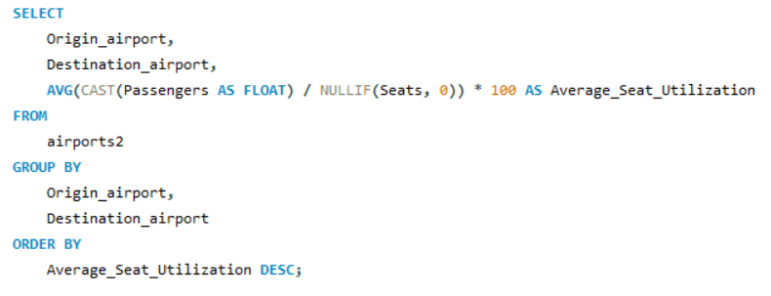
Problem Statement 2 :
Here the goal is to calculate the average seat utilization for each flight by dividing the number of passengers by the total number of seats available.
The results will be sorted in descending order based on utilization percentage.
This will help identify flights with the highest and lowest seat occupancy, providing valuable insights for optimizing flight capacity and enhancing operational efficiency.

Slide 5
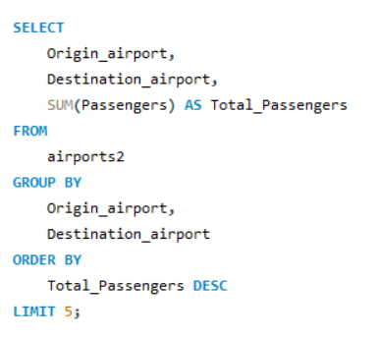
Problem Statement 3 :
The aim is to determine the top 5 origin and destination airport pairs that have the highest total passenger volume.
This analysis will reveal the most frequented travel routes, allowing airlines to optimize resource allocation and enhance service offerings based on passenger demand trends

Slide 6
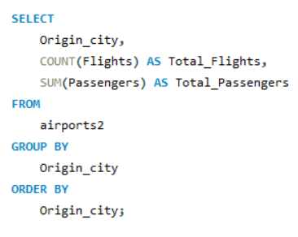
Problem Statement 4 :
The objective is to calculate the total number of flights and passengers departing from each origin city.
This will provide insights into the activity levels at various origin cities, helping to identify key hubs and inform strategic decisions regarding flight operations and capacity management.

Slide 7
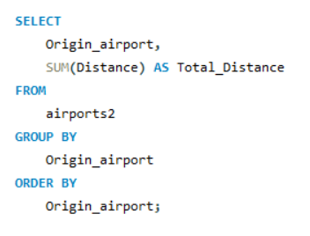
Problem Statement 5 :
The aim is to calculate the total distance flown by flights originating from each airport.
This analysis will offer insights into the overall travel patterns and operational reach of each airport, helping to evaluate their significance in the network and inform future route planning decisions.

Slide 8
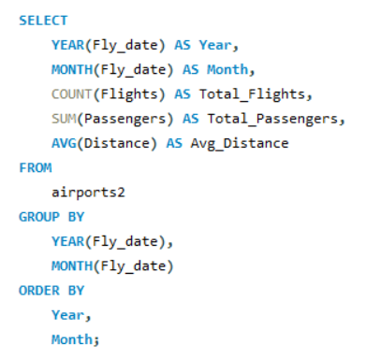
Problem Statement 6 :
The objective is to group flights by month and year using the Fly_date column to calculate the number of flights, total passengers, and average distance traveled per month.
This analysis will provide a clearer understanding of seasonal trends and operational performance over time, enabling better strategic planning for airline operations.

Slide 9
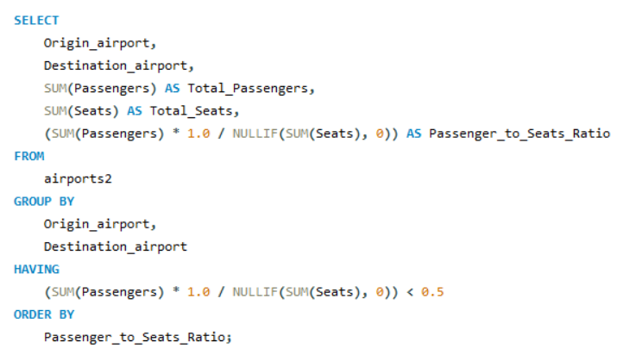
Problem Statement 7 :
The goal is to calculate the passenger-to-seats ratio for each origin and destination route and filter the results to display only those routes where this ratio is less than 0.5.
This will help identify underutilized routes, enabling airlines to make informed decisions about capacity management and potential route adjustments.

Slide 10
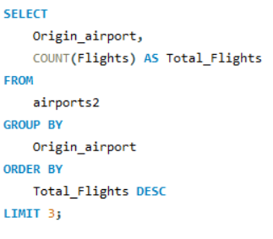
Problem Statement 8 :
The aim is to determine the top 3 origin airports with the highest frequency of flights.
It will highlight the most active airports in terms of flight operations, providing valuable insights for airlines and stakeholders to optimize scheduling and improve service offerings at these critical locations.

Slide 11
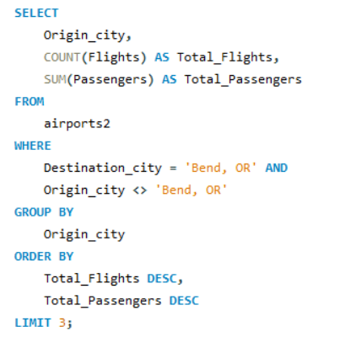
Problem Statement 9 :
The objective is to identify the city (excluding Bend, OR) that sends the most flights and passengers to Bend, OR.
This will reveal key contributors to passenger traffic at Bend, OR, helping airlines and travel authorities understand demand patterns and enhance connectivity from popular originating cities.

Slide 12
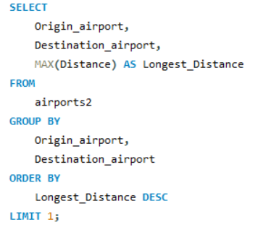
Problem Statement 10 :
The aim is to identify the longest flight route in terms of distance traveled, including both the origin and destination airports.
This will provide insights into the most extensive travel connections, helping airlines assess operational challenges and opportunities for long-haul service planning.

Slide 13
CHALLENGING QUESTIONS
PROBLEM STATEMENT FROM 11 TO 20

Slide 14
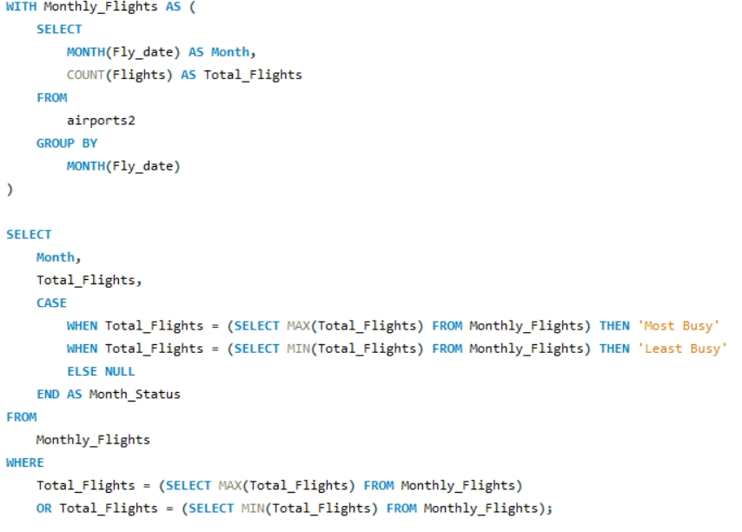
Problem Statement 11 :
The objective is to determine the most and least busy months by flight count across multiple years
This analysis will provide insights into seasonal trends in air travel.
Helping airlines and stakeholders understand peak and off-peak periods for better operational planning and resource allocation.

Slide 15
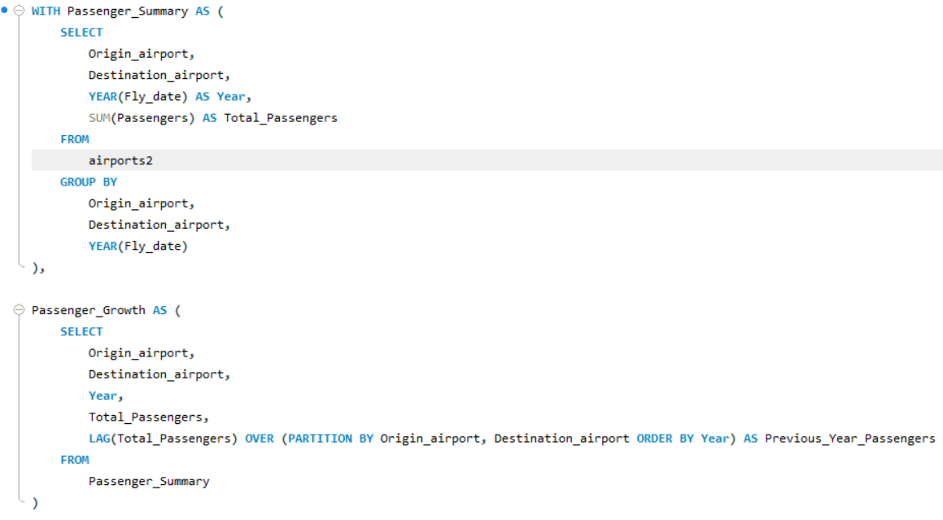
Problem Statement 12 :
The aim is to calculate the year-over-year percentage growth in the total number of passengers for each origin and destination airport pair.

Slide 16
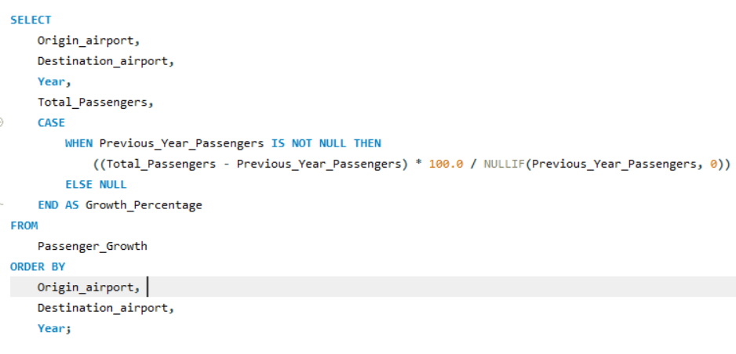
Problem Statement 12 :
This analysis will help identify trends in passenger traffic over time
Providing valuable insights for airlines to make informed decisions about route development and capacity management based on demand fluctuations.

Slide 17
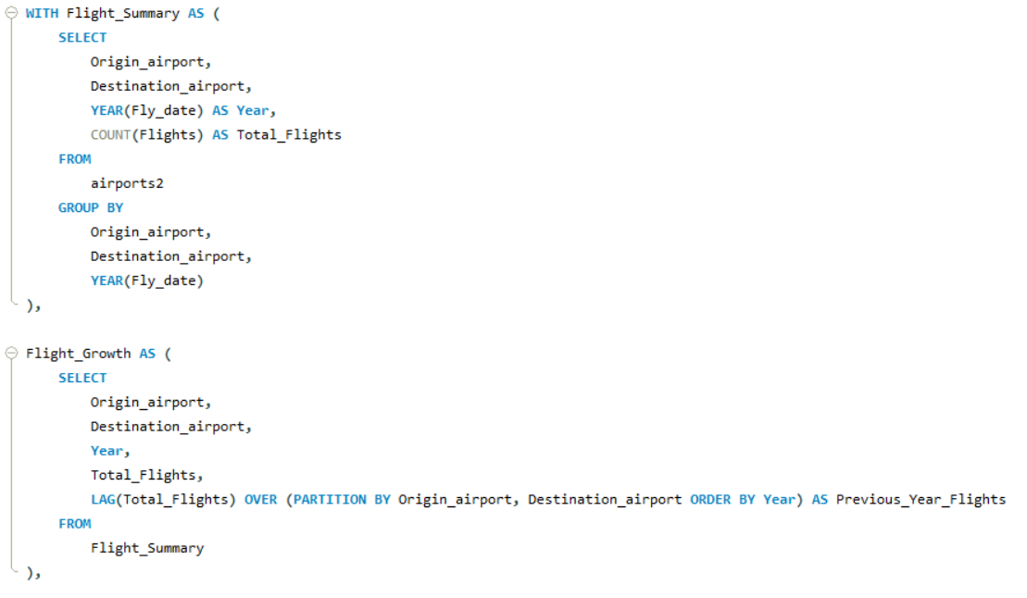
Problem Statement 13 :
The objective is to identify routes (from origin to destination) that have demonstrated consistent year-over-year growth in the number of flights.

Slide 18
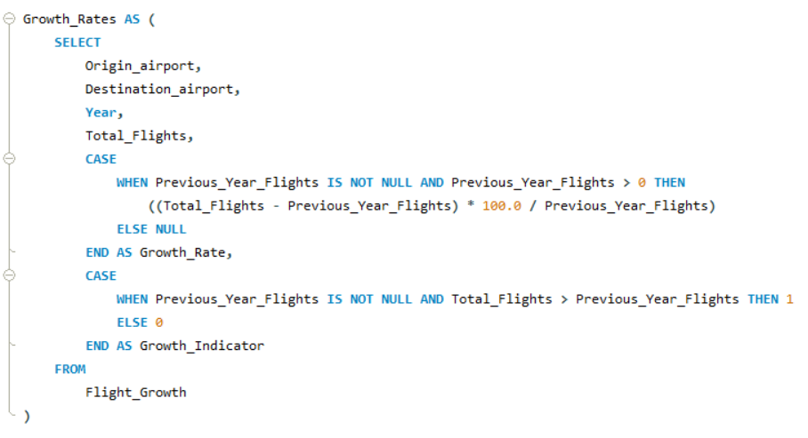
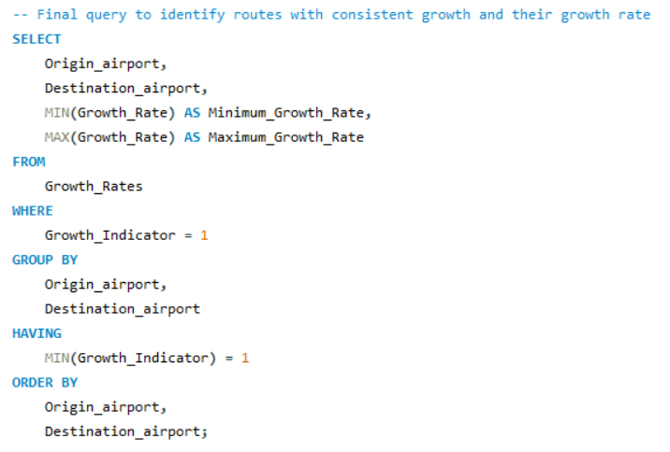
Problem Statement 13 :
This will help airlines understand which routes have not only grown consistently but also the magnitude of that growth in terms of percentage.
also it will highlight successful routes, providing insights for airlines to strengthen their operational strategies and consider potential expansions based on sustained demand trends.

Slide 19
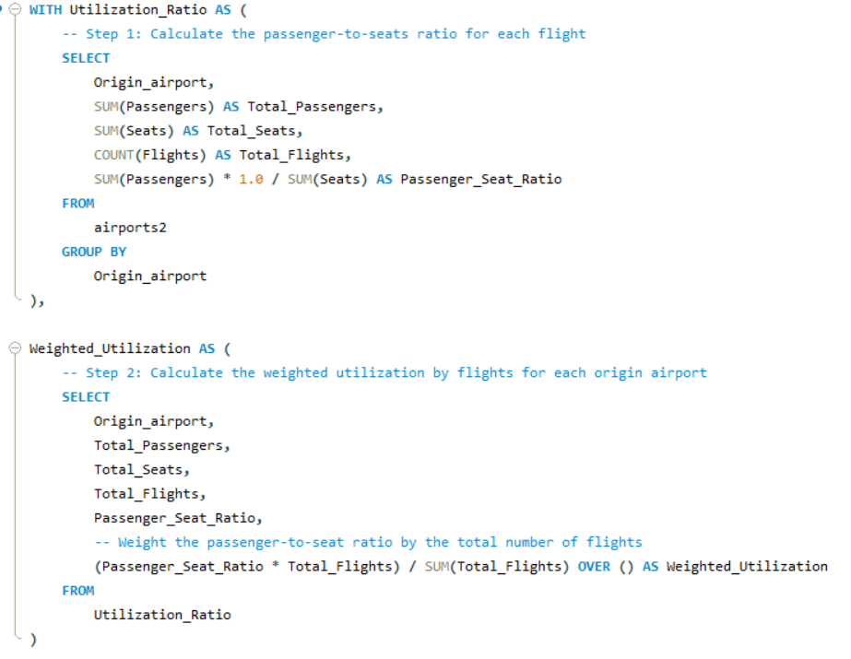
Problem Statement 14 :
The aim is to determine the top 3 origin airports with the highest weighted passenger-to-seats utilization ratio, considering the total number of flights for weighting.

Slide 20
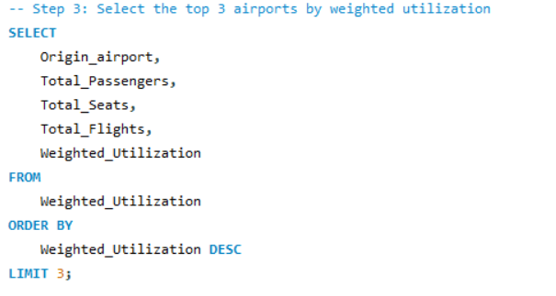
Problem Statement 14 :
It will highlight the top 3 origin airports that not only have good passenger-to-seat ratios but also perform well when the total number of flights is considered. It gives a more balanced view of operational efficiency by considering both the ratio and flight volume.

Slide 21
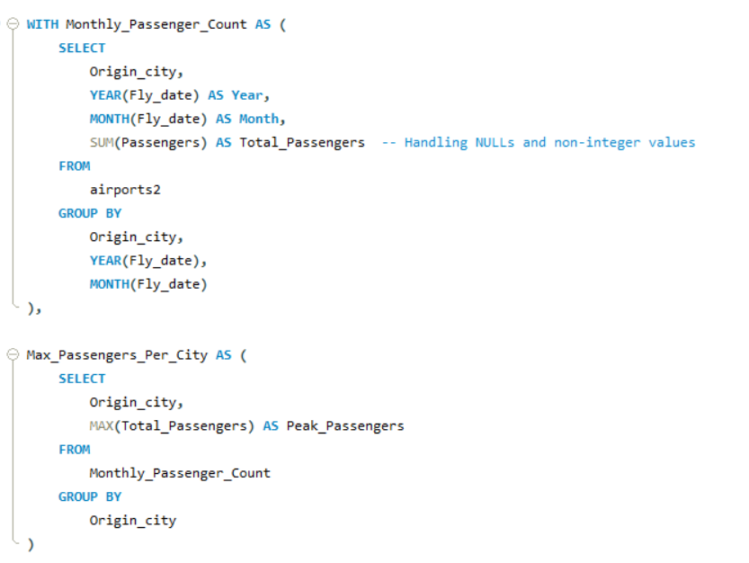
Problem Statement 15 :
The objective is to identify the peak traffic month for each origin city based on the highest number of passengers, including any ties where multiple months have the same passenger count.

Slide 22
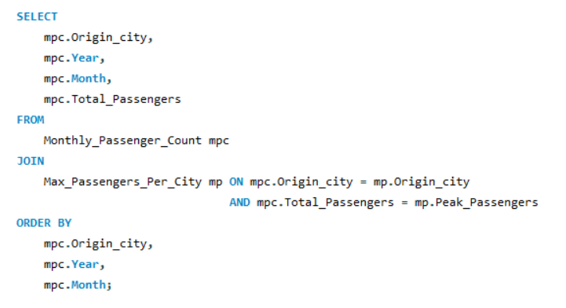
Problem Statement 15 :
This will help reveal seasonal travel patterns specific to each city,enabling airlines to tailor their services and marketing strategies to meet demand effectively.

Slide 23
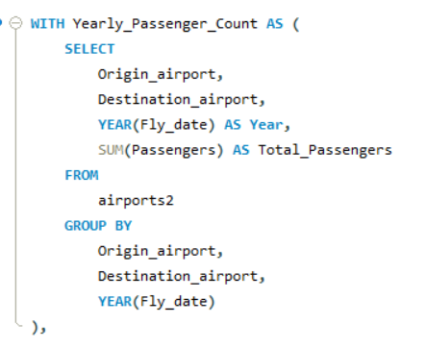
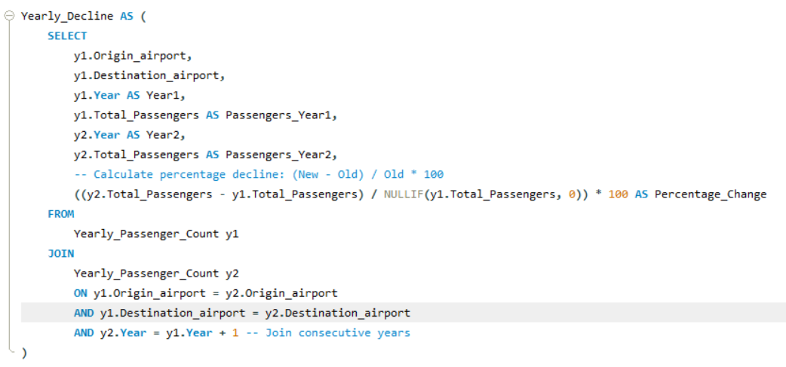
Problem Statement 16 :
The aim is to identify the routes (origin-destination pairs) that have experienced the largest decline in passenger numbers year-over-year.

Slide 24
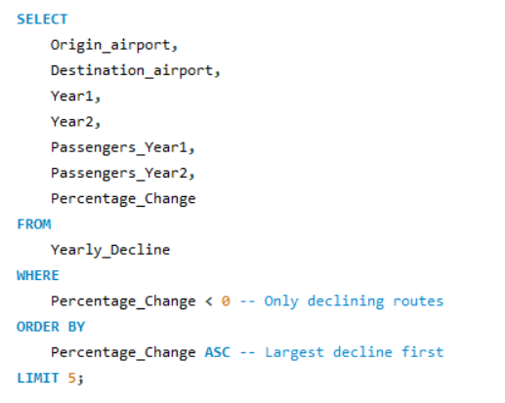
Problem Statement 16 :
This will help airlines pinpoint routes facing reduced demand, allowing for strategic adjustments in operations, marketing, and service offerings to address the decline effectively.

Slide 25
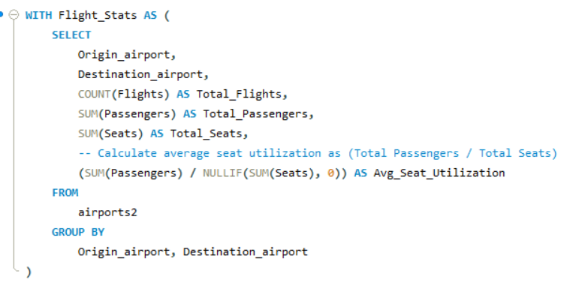
Problem Statement 17 :
The objective is to list all origin and destination airports that had at least 10 flights but maintained an average seat utilization (passengers/seats) of less than 50%.

Slide 26
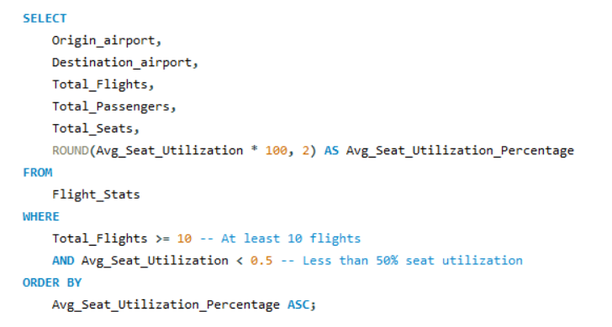
Problem Statement 17 :
It will highlight underperforming routes, allowing airlines to reassess their capacity management strategies and make informed decisions regarding potential service adjustments to optimize seat utilization and improve profitability

Slide 27
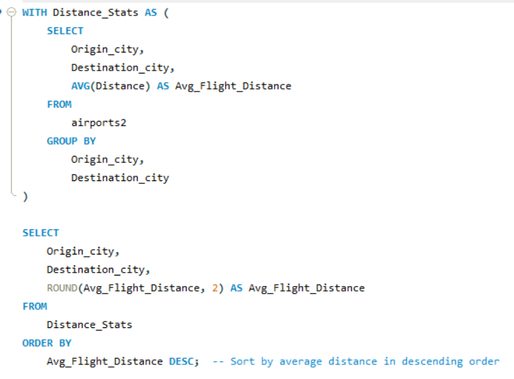
Problem Statement 18 :
The aim is to calculate the average flight distance for each unique city-to-city pair (origin and destination) and identify the routes with the longest average distance.
This analysis will provide insights into long-haul travel patterns, helping airlines assess operational consideration and potential market opportunities for extended routes.

Slide 28
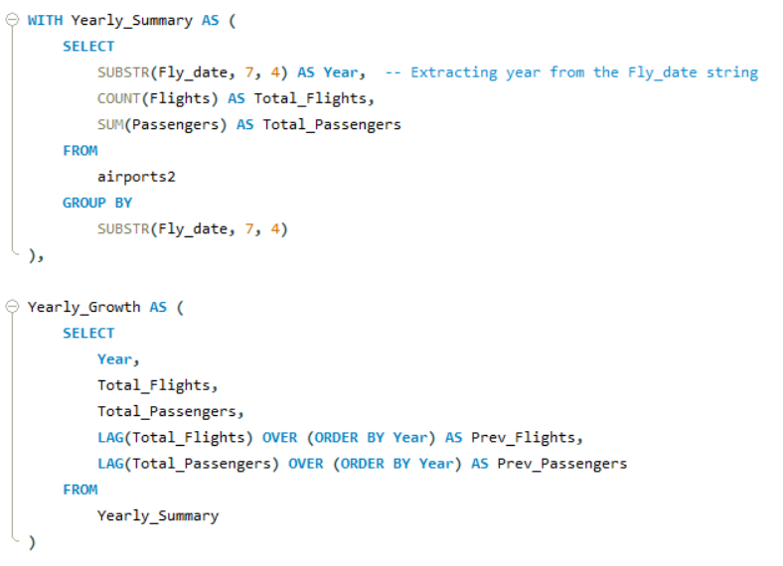
Problem Statement 19 :
The objective is to calculate the total number of flights and passengers for each year, along with the percentage growth in both flights and passengers compared to the previous year.

Slide 29
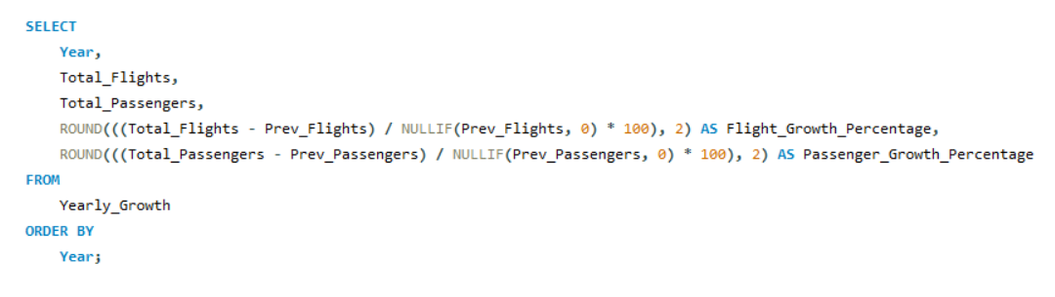
Problem Statement 19 :
It will provide a comprehensive overview of annual trends in air travel, enabling airlines and stakeholders to assess growth patterns and make informed strategic decisions for future operations.

Slide 30
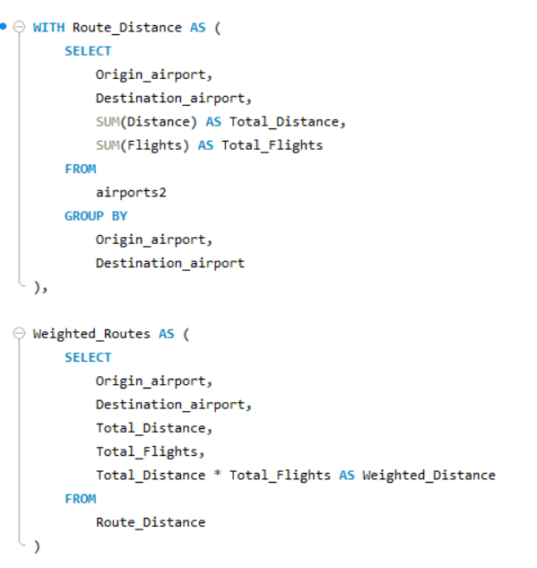
Problem Statement 20 :
The aim is to identify the top 3 busiest routes (origin destination pairs) based on the total distance flown, weighted by the number of flights.

Slide 31
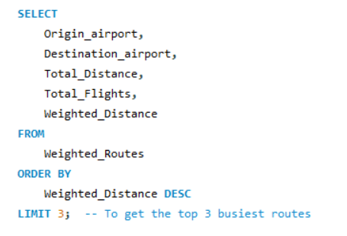
Problem Statement 20 :
This will highlight the most significant routes in terms of distance and operational activity, providing valuable insights for airlines to optimize their scheduling and resource allocation strategies.

Slide 32

Story telling : Identifying Operational Challenges in the Airline Industry
The airline faced several operational difficulties, ranging from declining route performance to underutilized flight capacity. Despite growing passenger demand in some areas, inefficiencies were noted across several routes, with some underperforming. Additionally, seasonal fluctuations weren’t being fully leveraged, leading to mismatches between supply and demand.
These problems created a ripple effect:
Declining profitability on key routes.
Wasted resources due to low seat utilization.
Missed opportunities for expansion and market leadership.
This led to the need for a comprehensive data analysis to pinpoint the root causes of these issues and drive actionable insights.

Slide 33
Insights Derived from Data Analysis(SQL)
By analyzing flight data, several critical factors were uncovered that were affecting overall performance:
Inconsistent Route Growth:
Certain routes were thriving while others showed a year-over-year decline in passenger numbers. This indicates that demand forecasting and route planning needed to be realigned.
Low Seat Utilization:
Routes with less than 50% seat utilization were identified, indicating over-capacity on flights. This was a major contributor to operational inefficiencies.
Seasonal Peaks in Demand:
Cities experienced predictable surges in passenger numbers during certain months, but the airline's scheduling wasn’t fully aligned with these peaks, leading to unbalanced resource allocation.
Distance Efficiency:
Long-distance routes with higher passenger volume were not being optimized, and in some cases, underperforming short-distance routes were over-served.

Slide 34
Proposed Strategic Solutions
To address these issues, the following strategies are proposed to enhance operational efficiency and increase profitability:
Route Optimization and Realignment:
Reduce flight frequency or capacity on underperforming routes with declining passengers.
Invest in expanding capacity on routes demonstrating consistent growth, as highlighted in the year-over-year trends.
Enhance Seat Utilization:
Realign aircraft sizes to better match passenger demand on low-utilization routes.
Implement dynamic pricing and targeted promotions to fill more seats, especially on off-peak flights.
Leverage Seasonal Demand:
Use historical data on peak months to increase flights or larger aircraft during high-demand periods.
Tailor marketing strategies to attract passengers during these seasons, ensuring full use of available capacity.
Maximize Long-Distance Route Efficiency:
Focus on routes with the longest average distance and significant passenger volume to ensure efficient resource allocation.
Explore potential to introduce additional services for high-demand, long-haul routes.

Slide 35

Conclusion and Stretegic Roadmap :
In conclusion, our data-driven approach has highlighted key operational inefficiencies and provided actionable insights to tackle these challenges.
The airline can:
Enhance profitability by focusing on high-growth routes and optimizing underperforming ones.
Improve resource allocation through better seat utilization and more efficient capacity management.
Capitalize on seasonal trends to match service levels with fluctuating passenger demand, maximizing revenue potential during peak months.
By implementing these strategies, the airline can position itself for sustainable growth, reduce operational costs, and offer a more consistent and satisfactory experience for passengers moving forward.
Thank You !

